Slide 1
IMPACT GSO + Challenger Rep Module
Shifting Trelegy Reps towards becoming Challenger Reps
Notes:
Target HCPs: Fence sitters, who thinks all SITTs are the same

Slide 2




2
Changing embedded habits
Behave differently
Science
Trigger
See/Feel differently “Emotion”
HCP habit
Notes:
Whichever Selling model you are using, creating constructive tension can be demonstrated in these steps.

Slide 3

3
How Change Happens!
Instantaneous
Accumulative
Unconscious
Notes:
.

Slide 4


How Challengers Win
Voice of the Customer*
I value sales professionals who…
Offer me unique, valuable perspectives on my market
Help me avoid potential risks
Educate me on new issues and outcomes
Help me navigate alternatives
Teach
Take Control
Constructive
Tension
Tailor
Shift behavior to compel the customer to take action
*Challenger Performance Optimization Inc. Research
Build
Constructive Tension
Notes:
According to Challenger Performance Optimization Inc. Research, customers value sales professionals who:
Offer me unique, valuable perspectives on my market
Help me navigate alternatives
Help me avoid potential risks
Educate me on new issues and outcomes
In their research, they also found that most effective Sales Reps Teaches, Tailors and Takes Control of the buying process – the Prescription process.
They call these sales professionals ‘CHALLENGERS’.
One of the key differentiators of these Challengers is that they BUILD CONSTRUCTIVE TENSION in order to Shift behavior to compel the customer to take action

Slide 5
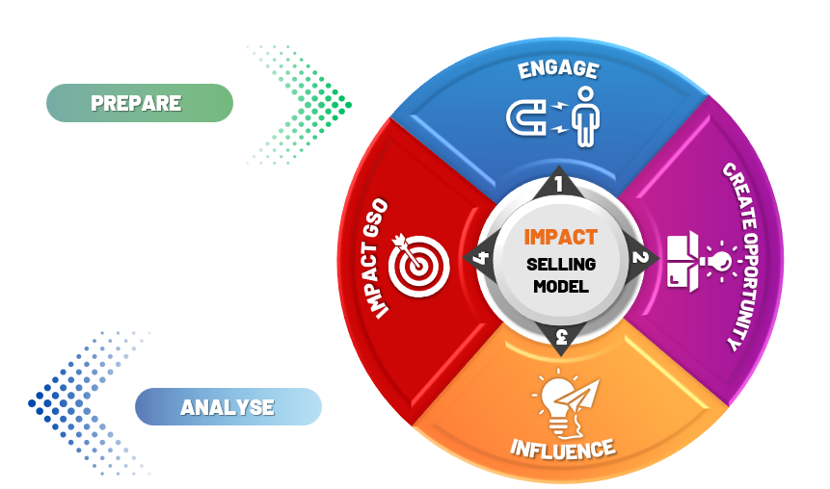
5
IMPACT Model
Challenger Rep
Notes:
Whichever Selling model you are using, creating constructive tension can be demonstrated in these steps.

Slide 6
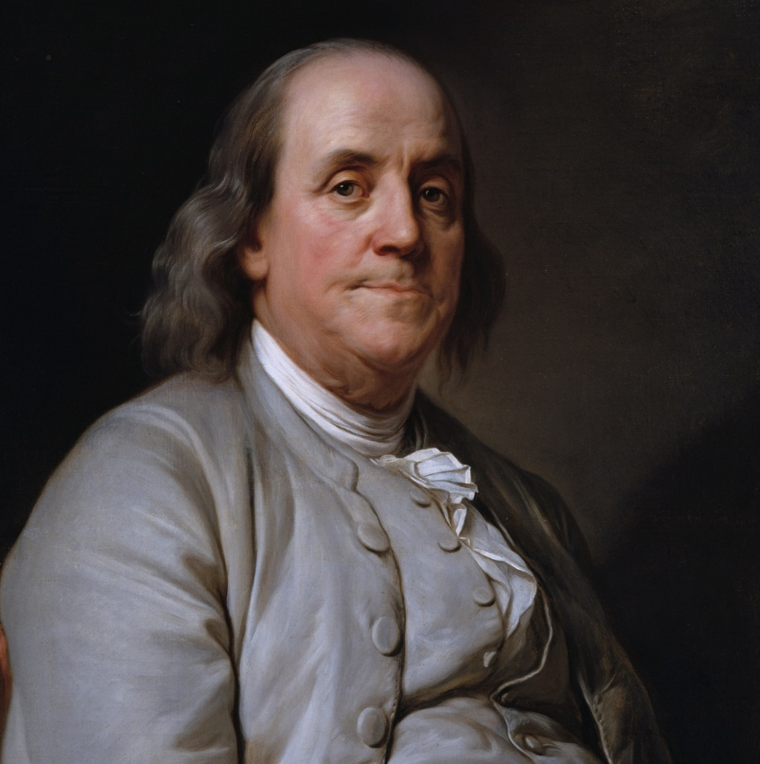


“By failing to prepare you are preparing to fail.”
Benjamin Franklin
Notes:
What to do/say:
Read the quote
Discuss what the preparation the participants think will be required.
The following topics should be covered under the preparations required: Do I understand the behaviors and preferences of the HCP persona I am scheduled to visit?
Do I have all the relevant information regarding the HCP’s patient profile, market, and competitors?
Do I have information about the past prescription patterns of the HCP for both TRELEGY & AREXVY?
Have I gone through my notes to recall my last interaction with the HCP so that I can build on where I left it off?
Basis the information available, can I evaluate which selling model am I likely going to use in this call with the HCP and can I define what I want to achieve from the call?
Do I have clarity on the promo grid and the methodology to be followed in deciding which brand pitch is to be prioritized?
Do I have all the relevant information and training required for a successful call / visit?

Slide 7


Understand HCP Perspective
PREPARE
Understand HCP RX Habit.
Understand HCP Behaviour.
Understand HCP Customers.
Set Commercial Objective
My objective is to ……………………………………………..
Link last call.
Identify appropriate Pt Profile.
Competitor.
Goals of the discussion

Slide 8




IMPACT Model + Challenger Rep
HCP Profile:
PREPARE
CREATE OPPORTUNITY
INFLUENCE
CLOSE WITH IMPACT GSO
ENGAGE
Notes:
What to do/say:
Give handout to all delegates

Slide 9





Engage
Rapport & Link to the last Call
ENGAGE
IMPACT
SELLING MODEL
IMPACT GSO
4
2
CREATE OPPORTUNITY
Align on the appropriate the patient
3
1
INFLUENCE

Slide 10

Building the conversation with an outside-in perspective, starting with emotive selling for common patient profiles in mind
Results of Effective Engagement
Builds Empathy with HCPs
Helps effectively identify the needs of the specific patient profiles
ENGAGE
Discussions with real patient profile helps drive relevance in the conversation
Specific patient profiles provide an anchor for discussions and help streamline the flow of the call
Notes:
What to do/say:
Discuss how engagement plays a key role in setting up for a successful call

Slide 11
IMPACT Model
HCP Profile:
PREPARE
CREATE OPPORTUNITY
INFLUENCE
CLOSE WITH IMPACT GSO
ENGAGE
Notes:
What to do/say:
Give handout to all delegates

Slide 12
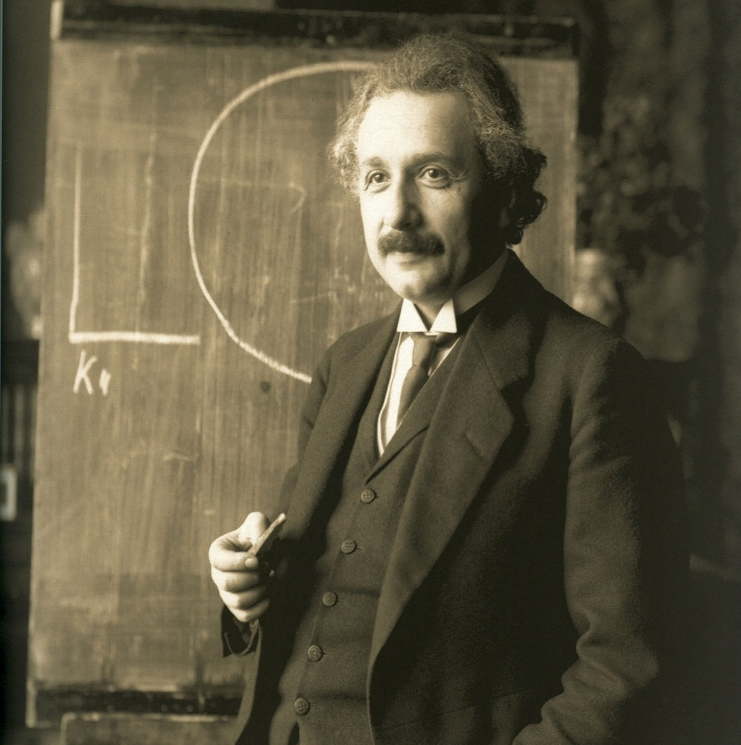
“If I had one hour to save the planet, I would spend 55 minutes defining the problem and 5 minutes resolving it.”
Albert Einstein
Notes:
What to do/say:
Albert Einstein said if he had one hour to save the planet, he'd spend 55 minutes trying to decide which is the problem he's trying to solve and 5 minutes developing the solution. A little bit extreme, but the essence makes a lot of sense, asking questions helps us to understand the unmet needs of the patient and the HCP

Slide 13

Create Opportunity
Challenger Rep
Challenge The Status Quo
CREATE OPPORTUNITY
Share Reframe
2
IMPACT
SELLING MODEL
ENGAGE
1
3
INFLUENCE
Introduce Impact
2
4
IMPACT GSO
Reveal Value
13

Slide 14



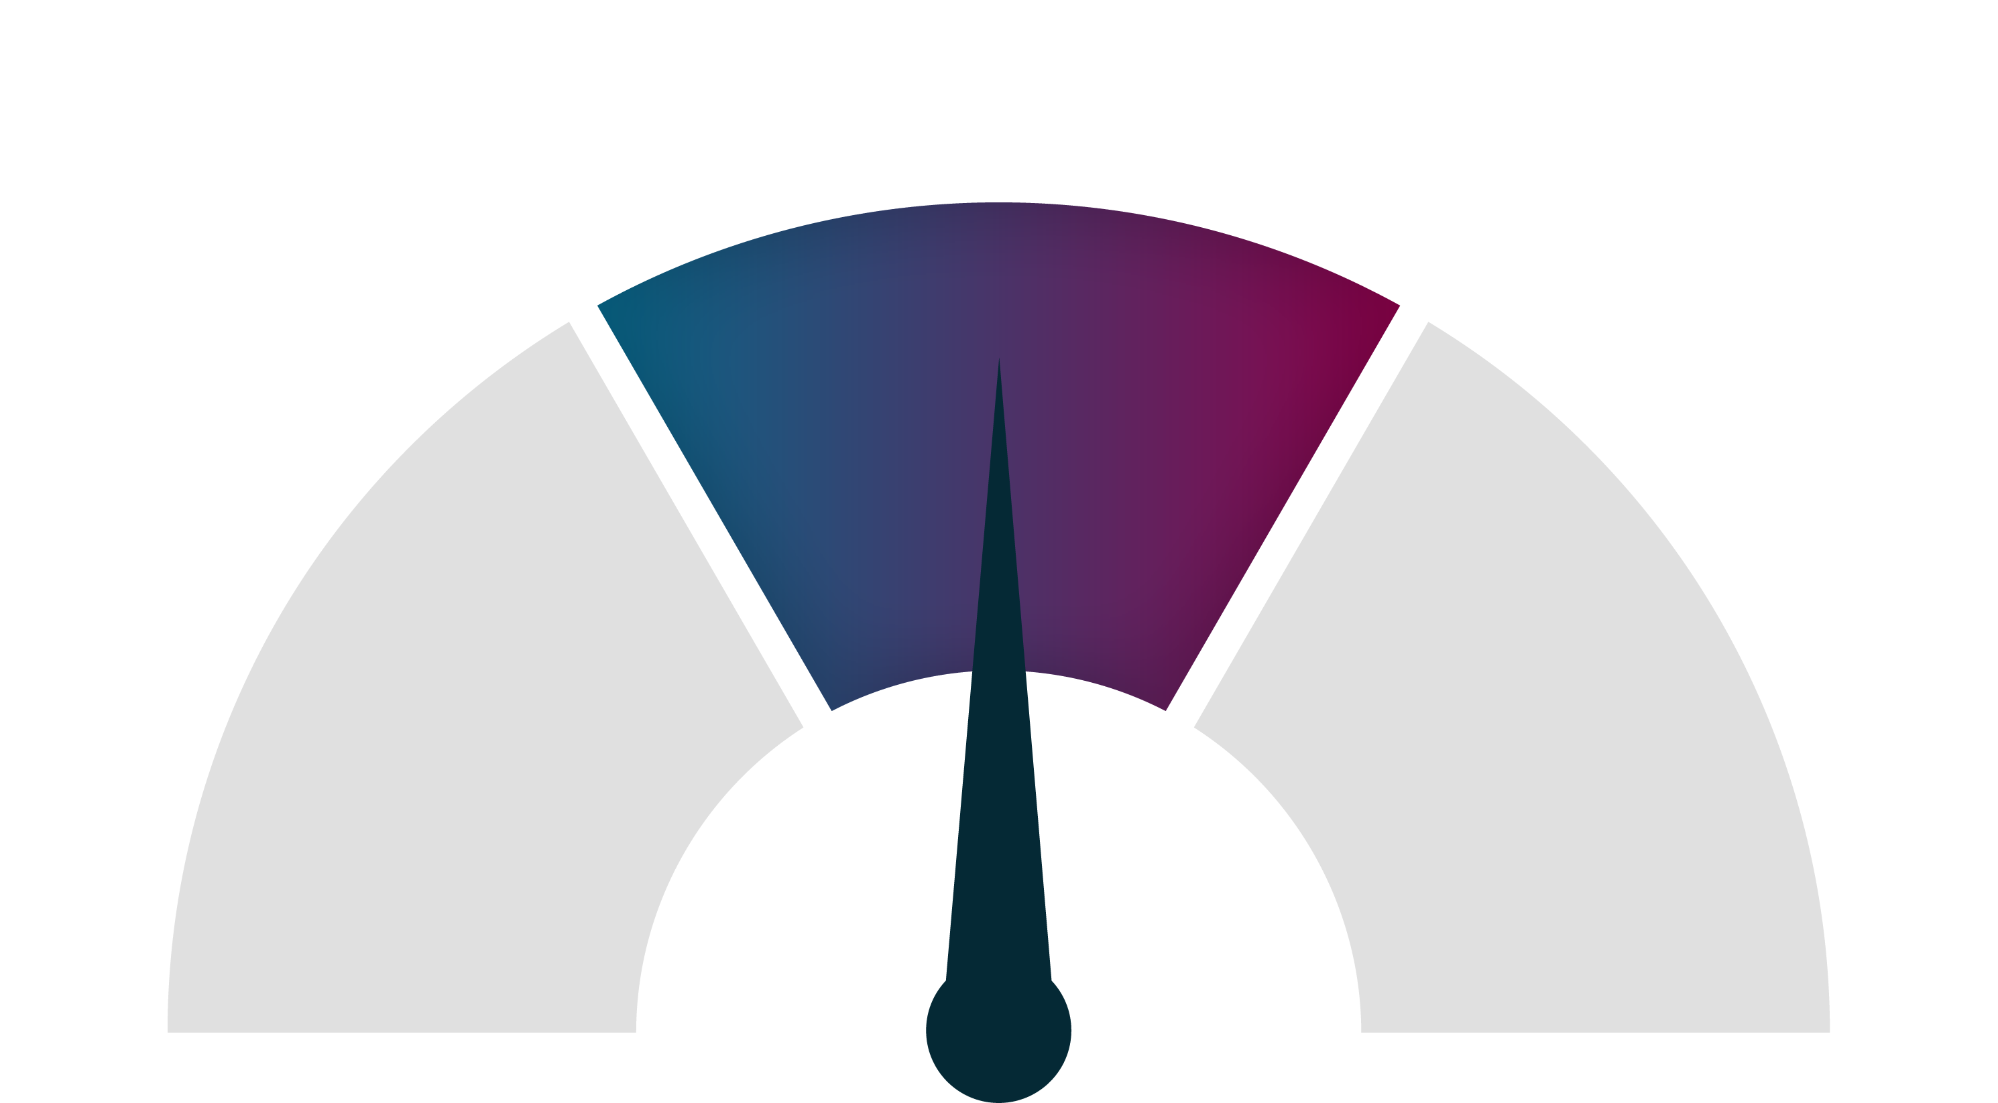
Challenge The Status Quo
Constructive Tension
A productive force that moves the interaction into unfamiliar and/or uncomfortable territory where the HCP feels compelled to take clinically appropriate action
Creating Constructive Tension
Constructive Tension
(Assertive)
No Tension
(Passive)
Too Much Tension
(Aggressive)
No tension
Too Much Tension
Relaxed
Leaning back in chair, at ease
Nonchalange (like information is old news or the customer doesn’t feel like they have a problem)
No need for action
Dial of Tension
Stressed
Arms crossed, shut down
Sounding defensive, heightened tone of voice
Refuses action, questions seller’s intentions
Intrigued
Leaning forward in chair, appears engaged
Asking lots of questions, may even seem skeptical (because gears are turning)
Need for action
Notes:
Construction tension is defined as a productive force that moves the interaction into unfamiliar and/or uncomfortable territory where the HCP feels compelled to take clinically appropriate action.
As sales professionals, most default is to avoid creating tension with a customer because you think that it is detrimental to your relationship…
…However if there is not enough tension in the call, the HCP will not be compelled to take any action
…Although in case of too much tension, they may feel personal affront and shut down on you
Therefore, you need to be skilled here to create the right amount of tension, to challenge the HCP’s thinking but not to challenge them personally. Ultimately, driving them to take a clinically appropriate action

Slide 15
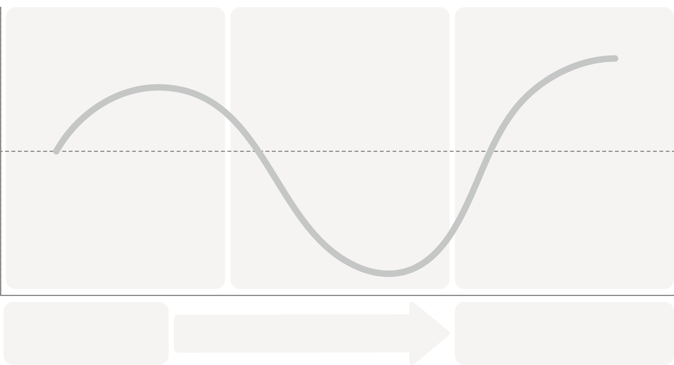
Challenger Rep 3-Phase Message
Positive
Share Reframe
Introduce Impact
Reveal Value
Customer Emotional State
Neutral
Negative
A
B
GAP
Current State
New Approach
Notes:
Let us zoom in on how we deliver the REFRAME or current state to GAP – this is the first bucket that you are seeing on the screen

Slide 16

Disrupting the Status Quo by addressing customer problem in a right way
Present an idea that changes how your customer views their situation or problem
A
B
GAP
Current State
New Approach
Captures the customer’s current thinking
What the customer is missing
Offers a new way to address the problem (leading to your solution)
3-Phase Message
(1) Share a reframe
(2) Introduce Impact
(3) Reveal Value
Notes:
According to Challenger, when we create Constructive tension, we disrupt the status quo. We do this by addressing the customet problem in a right way. What you are seeing is an abridged framework fo delivering a 3-phase message
Let us zoom in on how we deliver the REFRAME or current state to GAP

Slide 17



Characteristics of a Reframe
An Effective Reframe is…
Surprising
Sizable
Solvable
Must be unexpected
Must be worth solving
Must eventually lead back to you
17
Notes:
Insert – Surprising – DID YOU KNOW THAT EXACERBATIONS INCREASE….

Slide 18

Scripting Your Reframe
A
“HOWEVER”
Gap
Current State
Captures the customer’s current thinking
What the customer is missing
In your words, empathetically describe the status quo
Signal a pivot with a strong transition word or phrase
Reveal the flaw in that way of thinking about the issue
Sample Phrasing:
Last time we met, you explained…
Most pulmonologists tell us they are facing challenge…..…
From our conversations with KOLs, they have shared that…
When it comes to COPD treatment, we hear that most HCPs are challenged with…
Sample Phrasing:
…but…..
…unfortunately…
…the reality is…
…in contrast…
Sample Phrasing:
…this sector of patients is bigger than you think…
…your customers see this differently…
…the downstream issues are costly…
…this is will affect …….
18

Slide 19

Gathering your Inputs: Seek First to Understand
Suggested
Activity
Individual Activity
What is the general treatment goal of the HCP in treating COPD/Asthma?
How are they trying to accomplish #1 now?
(What are the positive things they are doing now, that they believe are actually doing something; these are things that DO NOT include the GSK Solution)
What makes sense (to them) about doing it this way?
(What logic/reasoning would they agree with? Be empathetic here; we don’t want to make them feel that their approach is a “bad” thing at this point.)
What’s at risk if they continue to do it this way?
(What don’t they see or fully appreciate?)
Notes:
UNDERSTAND PROBLEM FIRST BEFORE SOLUTION
Discipline not to mention brand

Slide 20
Developing a Reframe
Activity
A
Current State
Captures the customer’s current thinking
However,
Gap
What the customer is missing
20
Notes:
Develop a reframe anchored on your answers to the 4 questions

Slide 21
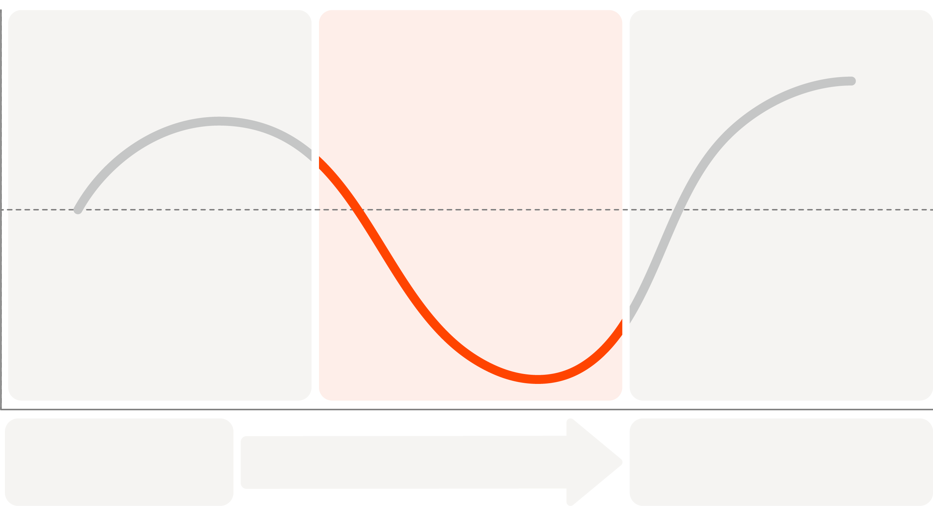
Focusing On: Introduce Impact
Introduce Impact:
Positive
Share Reframe
Introduce Impact
Reveal Value
Intensify the business consequences and humanize the problem by articulating the cost of staying the same.
Customer Emotional State
Neutral
Negative
A
B
GAP
Current State
New Approach
Notes:
Intensify the business consequences and humanize the problem by articulating the cost of staying the same.

Slide 22


FACT FINDING
Fact-finding questions provide us with information and knowledge, but don’t move us towards a solution.
Different Types of Questions to be able to create opportunity
OPPORTUNITY FINDING
Opportunity-finding questions show us the real problem and help us to identify what’s preventing something from happening but keep us stationary in the problem.
SOLUTION FINDING
Solution-finding questions tell us what will overcome the problem and move us towards a solution and an action.
22
Notes:
What to do/say:
There are 3 question types that we can use to create opportunity – fact finding questions (read example), opportunity finding questions (read example) and solution finding questions (read example)

Slide 23
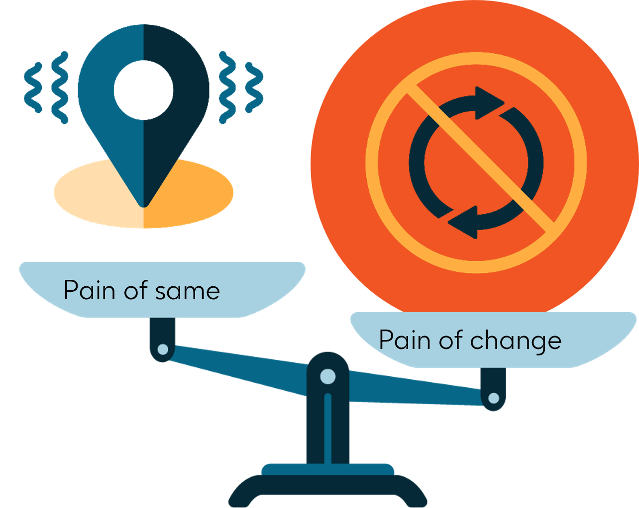
Introduce the Impact
Gain of change
Building the RATIONAL Case for Change
Building EMOTIONAL Case for Change
Emotional Impacts helps
Tell the Story of what the ‘Pain of Same’ looks like
Personalize impact by putting a human face to the problem
Risk of Exacerbations
All-cause mortality (ACM) risk
Notes:
Everyday our HCPs, in every patient encounter, need to make decisions. They need to balance patient outcomes, experience, guidelines etc. These decisions often come down to a choice: continue with established habits or embrace new approaches. This is where the concept of "pain of same" and "pain of change" comes into play.
In order to introduce the impact, there are 2 elements which must be present in order to be most effective…
First, the RATIONAL Case for change – this is where we anchor impact of sizable, quantifiable impact –
Second, the EMOTIONAL Case

Slide 24

Emotive selling
"People will forget what you said,
people will forget what you did,
but people will never forget how you made them feel." Maya Angelou
Creativity
Courage
Difference
Story Telling
Creating Analogies such as metaphors and similes
Using imagery
Quotes
e.g. Age, gender, suffer, history, story, activity, affect life, hospitalization
24
Notes:
What to do/say:
Read the quote by Maya Angelou
Emotive selling involves story telling to engage the HCP, creating analogies, using imagery and quotes to get your point across in a way that is professional but not robotic

Slide 25
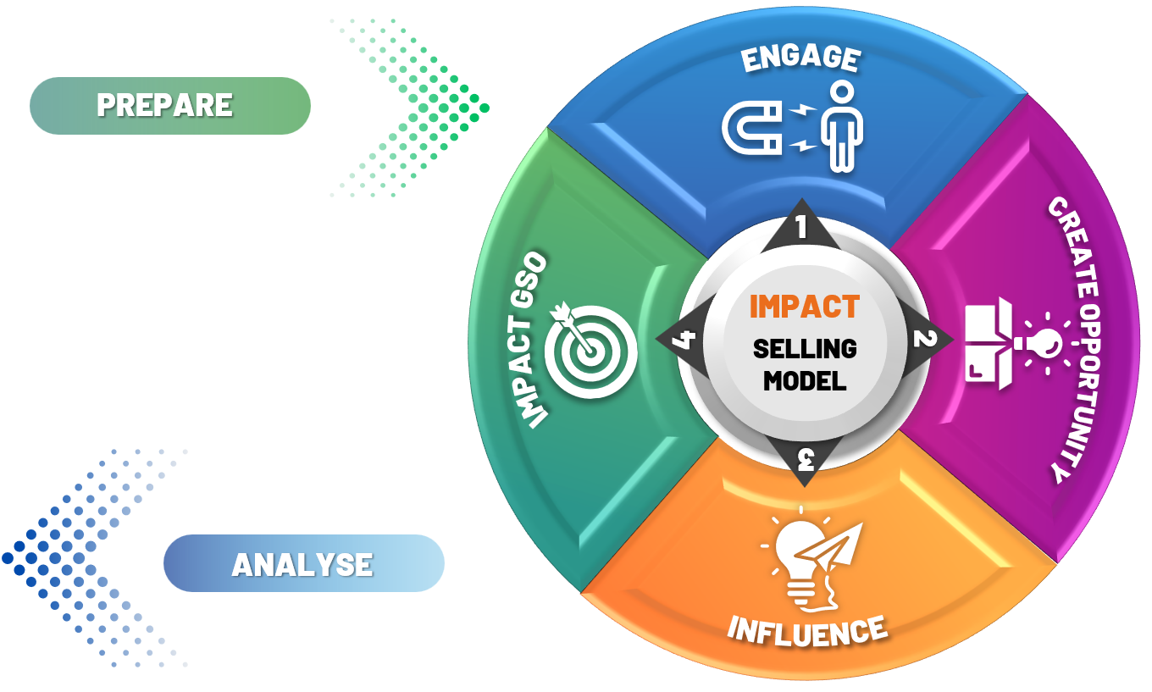
Use emotive selling in all the steps
Remember Emotive Selling is your way to convince the HCP by the value you add
Emotive selling should be present across all 5 steps of the patient centric selling model
In each step, you should refer to the patient anchored on in the beginning of the call
If you lose the patient, value for the doctor could be lost as well.
P1
Notes:
What to do/say:
Remember Emotive Selling is your way to convince the HCP by the value you add
Walk the delegates through the 3 points

Slide 26



EMOTIVE SELLING TACTICS
Utilize emotive selling concepts to convey the emotional case for change
Dial up the Constructive Tension your story creates with:
Vivid Equivalents
Connect abstract data points to a more concrete and relatable measure
Imagery
Incorporate details that invoke the five senses
Analogies
Create a comparison to make your point more memorable
Example: "That’s how our patients feel when they are experiencing exacerbations—like being caught underwater, desperately trying to reach the surface but held back by an invisible weight pressing down on their chest. Each inhale feels shallow and strained, as if the air they need is just out of reach. The overwhelming sense of suffocation can leave them panicked, exhausted, and unable to focus on anything else. Even simple activities, like walking across the room or climbing a few steps, can seem like insurmountable obstacles. This is the daily battle for many living with COPD, and it fuels our determination to create treatments that bring them relief and restore their ability to breathe freely."
Example:
"The simple act of walking across the room feels as draining as climbing 20 flights of stairs for someone without COPD."
"It’s like carrying a 50-pound weight on your chest while trying to run a marathon. The effort to draw in air feels overwhelming, and even resting doesn’t bring relief."
Example: like trying to sip air through a straw riddled with tiny holes
Notes:
FULL BUILD TIMING: 4 mins across 5 slides
SLIDE TIMING: 1 min RUNNING TIME: 2:35-2:36
FLOW (SLIDE 5 OF 5)
Discuss how to use vivid equivalents
TRANSITION
Again, the point of Emotional Impact is to help the customer get their head around just how bad things currently are…

Slide 27
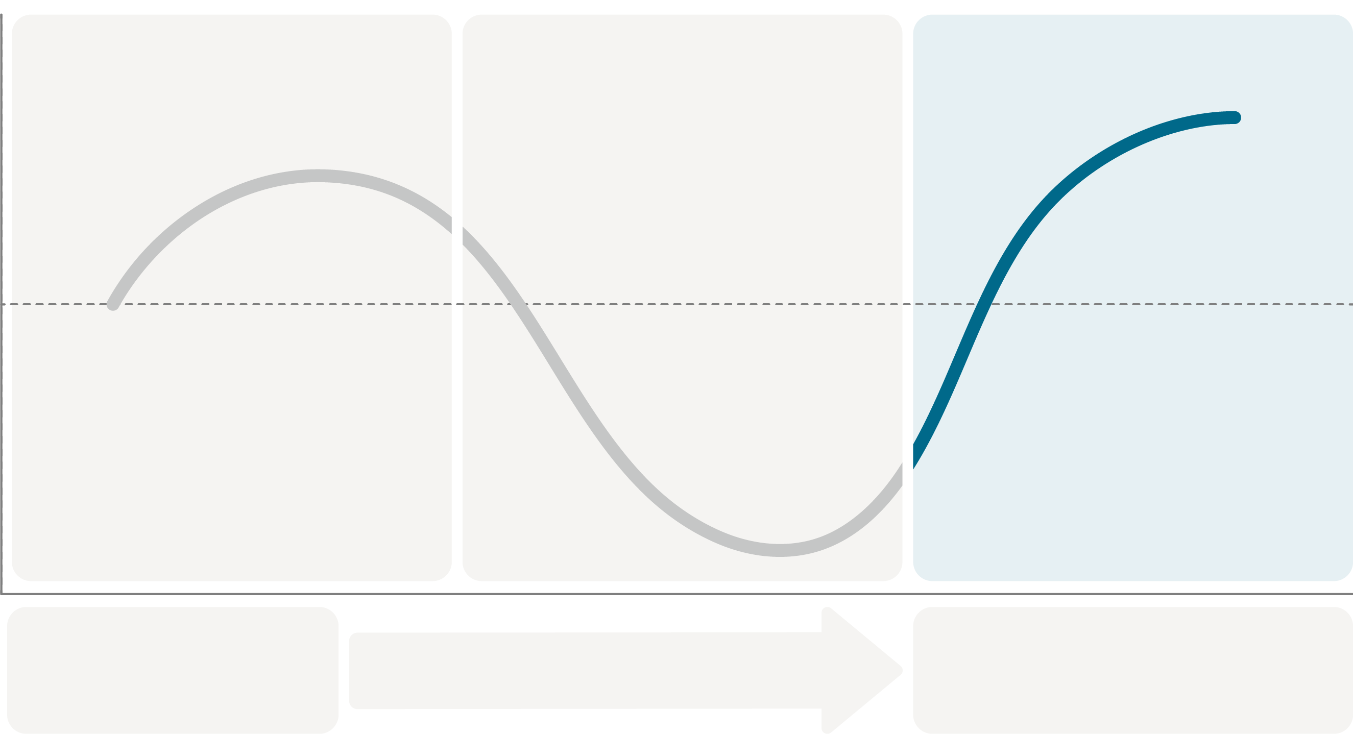
Focusing On: Reveal Value
Positive
Share Reframe
Introduce Impact
Reveal Value
Reveal Value:
Demonstrate the value of adopting a new way forward and reveal the distinctiveness of your solution.
Customer Emotional State
Neutral
Reveal Value of Trelegy
Negative
A
B
GAP
Current State
New Approach
Notes:
Now that you have introduced the impact, you may now be ready to reveal the value.
The objective is to Demonstrate the value of adopting a new way forward and reveal the distinctiveness of your solution.

Slide 28


Offering a New Way Forward
A
B
GAP
Current State
New Approach
Captures the customer’s current thinking
What the customer is missing
Offers a new way to address the problem (leading to your solution)
What should your customer do differently/how should they change their behavior?
How would your customer describe the new approach in their language?
Revealing Value might sound like:
The good news is, this is an easy fix…
Imagine if there was a way to…
Wouldn't it be great if you could…
Now imagine a scenario where instead of X you…
28
Notes:
SLIDE TIMING: 2 mins RUNNING TIME: 2:59-3:01
FLOW
Discuss the action the customer should take
Discuss the idea of differentiating your solution from others
TRANSITION
As you think about what this might sound like, we have a few ideas for you to consider…

Slide 29
IMPACT Model
HCP Profile:
s
PREPARE
CREATE OPPORTUNITY
INFLUENCE
CLOSE WITH IMPACT GSO
ENGAGE
Notes:
What to do/say:
Give handout to all delegates

Slide 30


Influence
Link Key Selling Messages to agreed patient
INFLUENCE
3
IMPACT
SELLING MODEL
CREATE OPPORTUNITY
2
4
IMPACT GSO
Handle objections
1
3
ENGAGE
30

Slide 31
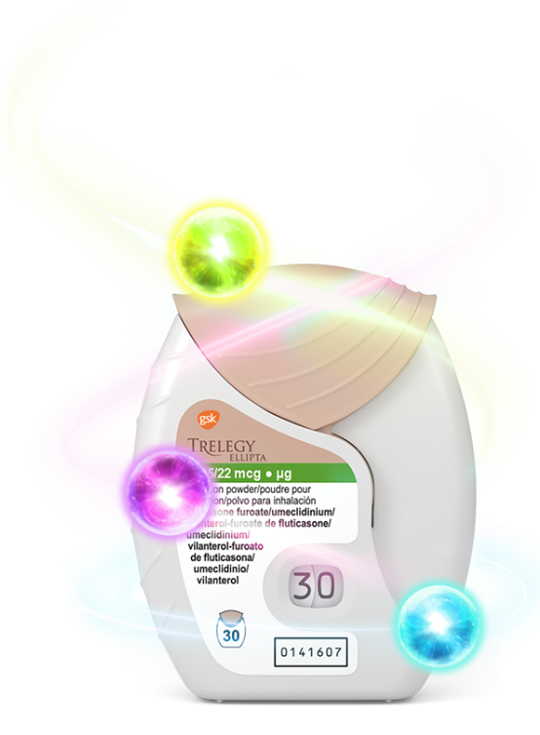
Key Messages
Improve Lung Function Vs ICS/LABA alone
Achieve clinically meaningful improvements in asthma control Vs ICS/LABA alone
Reduce exacerbation Vs ICSLLABA alone
Best in class Molecules
Delivered as one puff once daily in a super easy to use Ellipta device.
Approved in Asthma and COPD
Superior Lung Function Improvement (……) and provide Greater Moderate/Severe Exacerbation Reduction (……) Vs Breztri in COPD
Disclaimer : Must use locally approve e-detailers
Notes:
What to say/do:
Here are some key selling messages that we can use for Trelegy

Slide 32




Remember to address objections through
APACT
A
cknowledge
P
robe
A
nswer
C
onfirm
T
ransition
Notes:
What to do/say:
At GSK, we address objections through a helpful model called APACT. APACT stands for Acknowledge, Probe, Answer, Confirm and Transition
Whilst it may not always be possible to follow each and every stage of APACT in a formulaic way for every customer objection, applying the APACT model will help you move forward for most of the customer objections you encounter
Let’s look at each of these in detail now…

Slide 33
TRELEGY OBJECTIONS
DPI vs MDI
- Breztri is in MDI form, Aerosphere.
- small particle size for more lung deposition.
Inspiratory flow Rate
Patient familiarization
Particle size, lung deposition
Onset of action
Breztri is claiming that it has fast onset of action within 5 mins.
Regime (OD vs BD)
Trelegy will not cover 24hrs of asthma variability with once daily.
More frequent administration of ICS is assuring lung protection.
ICS role in COPD
Adding ICS increase the risk of pneumonia for COPD Patients
TRELEGY vs Breztri in COPD
I do prefer to shift from Symbicort to Breztri:
- Keeping the same ICS/LABA - Moving to MDI for more patientconvenient/lung deposition/ease of use
I do prefer to shift from Symbicort to Breztri:
Keeping the same ICS/LABA
Moving to MDI for more patient convenient/lung deposition/ease of use
TRELEGY vs Breztri in Asthma
LAMA role in Asthma
I may consider adding LAMA after increasing ICS dose
I don’t believe in LAMA role in Asthma.
SITT vs ICS/LABA in adverse event.
SITT SAFETY
LAMA EFFICACY
Price Handling
Confidential, for internal training purposes only - not to be shared externally

Slide 34
IMPACT Model
HCP Profile:
PREPARE
CREATE OPPORTUNITY
INFLUENCE
CLOSE WITH IMPACT GSO
ENGAGE
Notes:
What to do/say:
Give handout to all delegates

Slide 35
IMPACT GSO
Notes:
What to do/say:
We’ll now look at the Impact GSO step

Slide 36

Secure the HCP’s commitment to implementing behavioral changes based on the compelling solutions discussed for the PT in focus
Traditional closing tactics
Alternative approach to getting a commitment to action
Traditional models typically start with open questions and lead to closed questions. Closed, decision-making questions are asked at the end of an interaction. A ‘yes’ answer usually results in the representative leaving
A different approach is to ask OPEN questions at the end of an interaction. This avoids the obvious ‘yes’ or ‘no’ answer from the customer and encourages actions to be volunteered by the HCP
Open
questions
Summarise the discussion (Revisit shared objective if appropriate)
Closed questions
Answer…
OPEN questions to elicit HCP-volunteered commitment
CLOSED question to confirm/gain agreement
Notes:
Facilitator notes:
Traditional closing tactics:
Key messages:
In the pharmaceutical industry, customers see pharmaceutical company employees on a regular basis. Even if the average HCP only sees two representatives a week, it means that they could be seeing approximately 100 in a year. If they are seeing 100 in a year and they have been in practice for 10 years, they would have had 1000 contacts with pharmaceutical representatives over their career
This means that they have expectations about what representatives will say and do. They also know how to deal with representatives and what to say if they want them to leave!
If a representative reaches the end of their sales call and asks the customer to put the next five patients on their drug, the customer could reasonably be expected to say ‘yes’, ‘no’ or ‘maybe’
They know that if they answer ‘no’ or ‘maybe’, the representative is likely to commence selling their product again as they have not convinced the HCP to prescribe it
They also know that if they say ‘Yes’, most representatives will say thank you and leave the room!
A ‘yes’ to a request to prescribe is not enough to ensure that the customer will prescribe the representative’s product
An alternative approach to getting a commitment to action:
Key messages:
An alternative approach is for the rep to coach the customer towards the solution
You will still ask closed questions to confirm that you and the HCP are in agreement and that they are happy to make the change
However:
You will then ask OPEN questions on how this will happen so that the HCP will generate the next steps by themselves

Slide 37
IMPACT Model
HCP Profile:
PREPARE
CREATE OPPORTUNITY
INFLUENCE
CLOSE WITH IMPACT GSO
ENGAGE
Notes:
What to do/say:
Give handout to all delegates

Slide 38
ROLE PLAYS
Notes:
What to do/say:
We’ll now look at the Impact GSO step

